Slide 1
VIIRS Low Light Imaging Applications
Christopher D. Elvidge, Ph.D.
Earth Observation Group
NOAA National Geophysical Data Center
Boulder, Colorado USA
chris.elvidge@noaa.gov
Kimberly Baugh, Feng-Chi Hsu, Mikhail Zhizhin, Tilottama Ghosh
Cooperative Institute for Research in the Environmental Sciences
University of Colorado
November 21, 2014

Slide 2
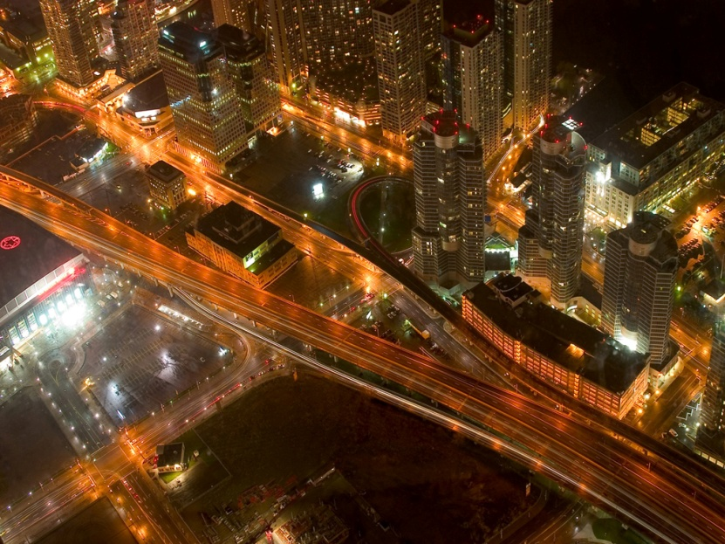
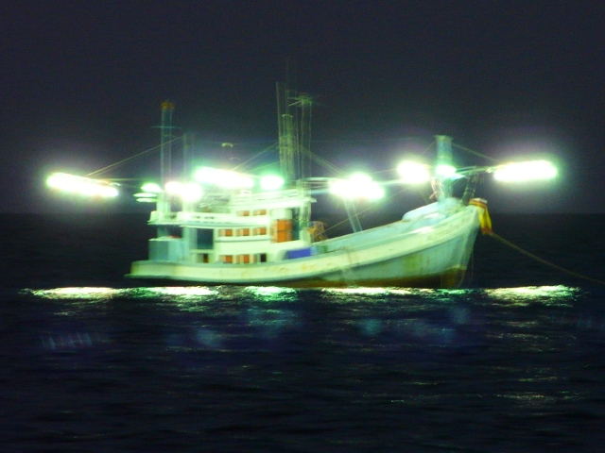
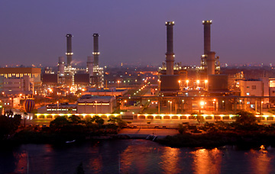
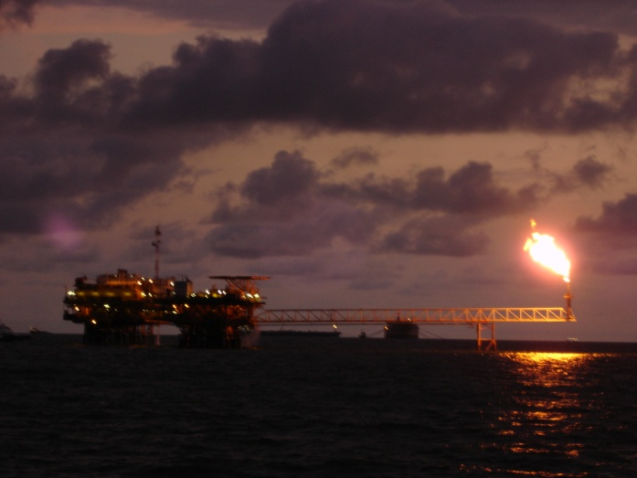
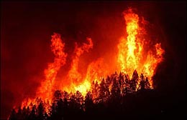
Lights
At
Night!
Boats
Cities and human
settlements
Industrial Sites
Gas Flares
Fires

Slide 3
VIIRS Low Light Imaging
Signal intensification to detect faint radiant emissions – the DNB.
Collection of daytime channels at night to detect radiant emissions that are obscured by reflected sunlight.

Slide 4
VIIRS Provides Improved Spatial Resolution Fishing Boat Detections
VIIRS October 15, 2012 01:30
DMSP-OLS October 14, 2012 19:30

Slide 5
What Makes VIIRS Better Than DMSP?
The VIIRS DNB footprint is 45 times smaller than the DMSP pixel footprint!
DMSP OLS
5 km² footprint
VIIRS Day / Night Band
742 m² footprint

Slide 6
What Else Makes VIIRS Better Than DMSP?
Quantization: VIIRS 14 bit versus 6 bit for DMSP.
Dynamic Range: Due to limited dynamic range, DMSP data saturate on bright lights in operational data collections.
Lower Detection Limits: VIIRS can detect dimmer lighting than DMSP.
Quantitative: VIIRS is well calibrated, the DMSP visible band has no in-flight calibration.
Multispectral: VIIRS has additional spectral bands to discriminate combustion sources from lights and to characterize the optical thickness of clouds.

Slide 7
Current Status of NGDC DNB Products
Nightly mosaics in png and Google Earth Super-overlay formats http://ngdc.noaa.gov/eog/viirs/download_ut_mos.html
Rough monthly averages. Four preliminary products are available at: http://ngdc.noaa.gov/eog/viirs/download_monthly.html
Monthly and annual cleaned nighttime lights still in development
With stray light correction
Free of solar, lunar, aurora, South Atlantic Anomaly detector hits
Filtered to remove lightning
Combustion sources removed
Background noise removed

Slide 8
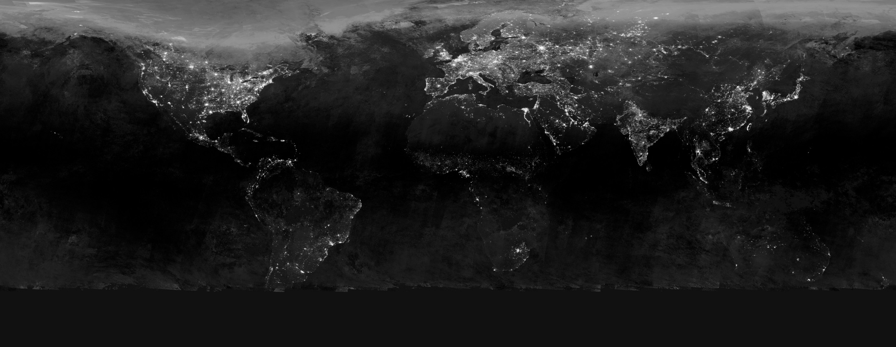
Average VIIRS DNB Composite - January 2013 Contrast Enhanced to Show the Flaws
Aurora
Sunlit
Dimensions 86400 x 33601. Too large to output as GEOTIFF!
Original units multiplied by a billion (E9) to yield nanoWatts/(cm^{2.}sr)
NGDC is working on algorithms to make research quality nighttime lights: removal of background noise, aurora, ionospheric detector hits, lightning, fires, fuzzy lights.

Slide 9
Color composite of three monthly average DNB products. 201204 = blue 201301 = green 201405 = red Blue indicates power outages in 2013 and 2014. Purple indicates power outage in 2013.
Nighttime lights should be used cautiously in LCLUC
analyses due to their plasticity
Syria

Slide 10
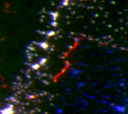
Color composite of three monthly average DNB products. 201204 = blue, 201301 = green, 201405 = red
Syria
Red lines on Turkish side of border.
Refugee camps? 24 hour border control operation?

Slide 11
VIIRS DNB Boat Detection System (Prototype)
An automatic system to report the date, time, location and radiance of boat detections.
Output as csv and kmz.
Kml provides a semi-transparent contrast enhanced DNB image
Prototyping is being done in Indonesia, sponsored by USAID.
Customer is the Indonesia Ministry of Marine Affairs and Fisheries.
System works well when moonlight is low.
Second round of development will focus on high lunar conditions.
Analog to fire detection products.
http://www.ngdc.noaa.gov/eog/viirs/download_indo_boat.html

Slide 12
Boat Detection Flow Chart

Slide 13
Sharpness Index Cuong T. Vu and Damon M. Chandler, "S3 A Spectral and Spatial Measure of Local Perceived Sharpness in Natural Images", IEEE Transaction on Image Processing, 21 (3), September 2011.

Slide 14
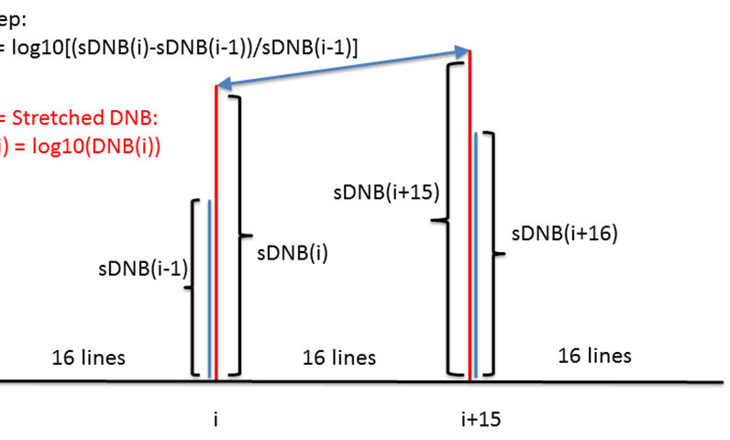
Lightning Detection

Slide 15
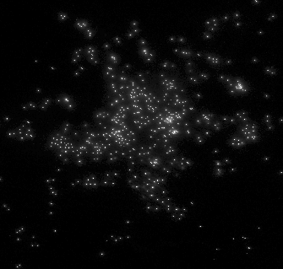
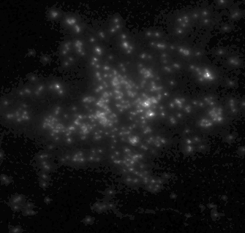
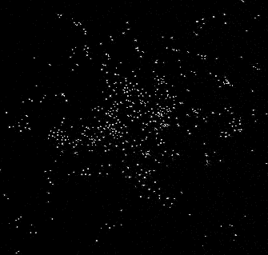
DNB Spike Detector
DNB
Median
Filtered
DNB
(despiked)
DNB minus despiked
With background suppressed a threshold is used to detect the spikes

Slide 16
Transect Across Boat Cluster

Slide 17
Transect Across Boat Cluster

Slide 18
Remove detections on land

Slide 19
Boat Detections Running for Indonesia DNB as semi-transparent overlay

Slide 20
Boat Detections Running for Indonesia

Slide 21
VIIRS Nightfire (VNF): A global multispectral fire product
Nine channels of data are collected at night
M11
Approved
Nighttime collection of channel 11 is expected to start in 2015

Slide 22
Gas flares are readily detected in the VIIRS M10 spectral band

Slide 23
Detection Limits At 1800 K flares as small as 0.25 m² are detectable
Biomass
Burning
Flares
Gas Flares
M13
M10

Slide 24
Bakken Oil Field DNB March 10, 2013

Slide 25
Overlay M10 as red. 352 lights. 104 flares. 29.5%!

Slide 26
Why Multispectral?
To get at the Planck curves!
Daily files are in csv and kmz formats

Slide 27
Typical Biomass Burning Detection
Lower temperature than gas flaring.
Often these have larger source size than gas flares.
North Dakota

Slide 28
Daily VNF data are available at: http://ngdc.noaa.gov/eog/viirs/download_viirs_fire.html
Current processing typically runs with a four hour delay

Slide 29
Applications for VNF data
NGDC uses the data map and track gas flaring worldwide.
Estimation of carbon and Nox emissions from gas flaring.
Prospecting favorable sites for natural gas recovery.
VNF temperatures and source sizes may be useful in modeling fire induced land cover change.
As an indicator of encroachment into protected and high biodiversity value areas.

Slide 30
EOG Publications
VIIRS Nightfire: Satellite pyrometry at night http://www.mdpi.com/2072-4292/5/9/4423
What is so great about nighttime VIIRS data for the detection and characterization of combustion sources? http://dx.doi.org/10.7125/APAN.35.5
Using the short-wave infrared for nocturnal detection of combustion sources in VIIRS data. http://dx.doi.org/10.7125/APAN.35.6
Why VIIRS data are superior to DMSP for mapping nighttime lights. http://dx.doi.org/10.7125/APAN.35.7
Nighttime lights compositing using the VIIRS day-night band: Preliminary results . http://dx.doi.org/10.7125/APAN.35.8
Illuminating the capabilities of the Suomi NPP VIIRS
Day/Night Band. http://dx.doi.org/10.3390/rs5126717

